Slide 1
Basement membrane (fibrosis) changes in healthy vs Alzheimer’s condition
Vineetha Guttha
Department of Pharmaceutics
PHSL 5221

Slide 2


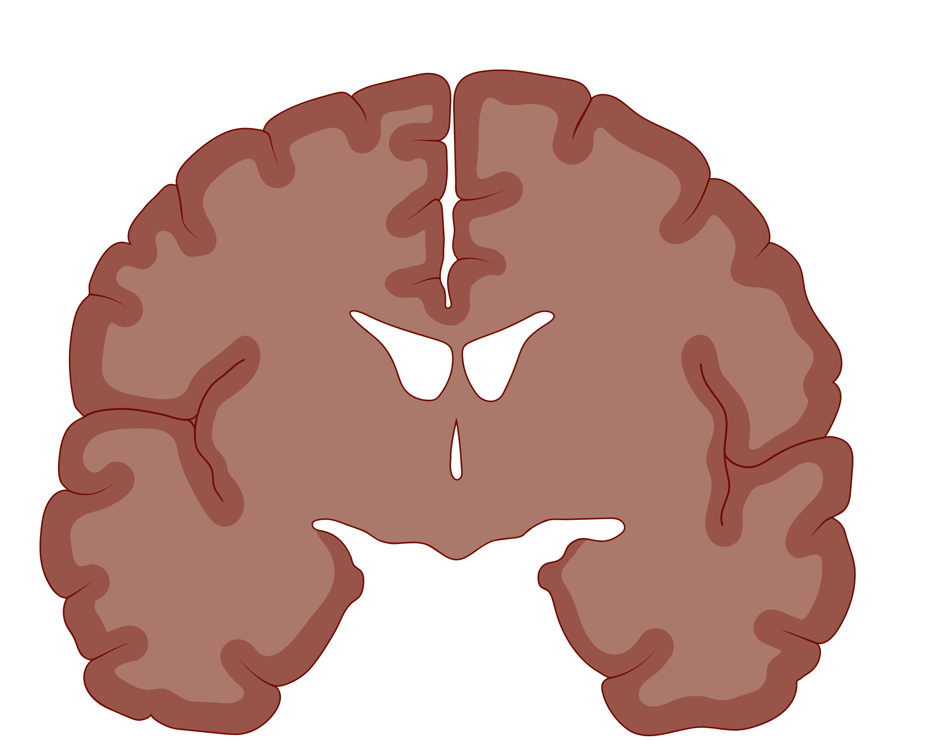
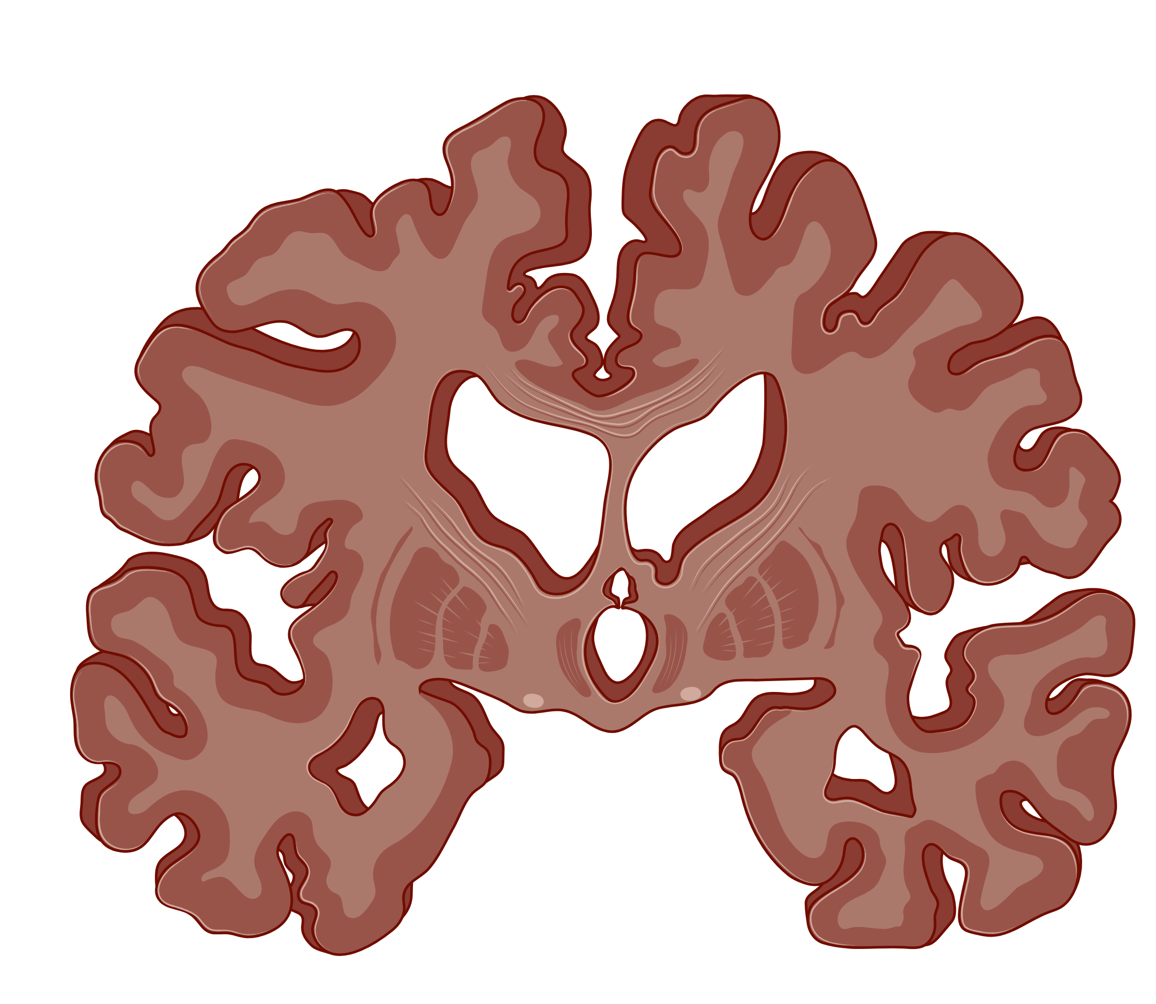
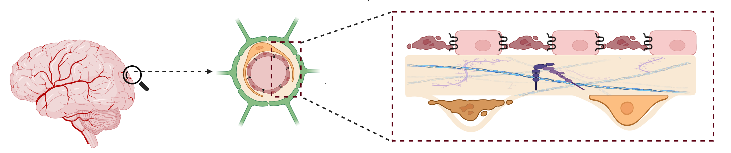
Alzheimer’s Disease
Dementia
Difficulty planning
Confusion with time, place
Change in mood, personality
7 million Americans were living with Alzheimer’s_2021
fifth-leading cause of death in people>65years
Blood-Brain Barrier (BBB) dysfunction
Bedse et al. Front. Neurosci. 9:204. doi: 10.3389/fnins.2015.00204
1
Notes:
Alzheimer’s brain : https://openmedscience.com/brain-imaging-in-alzheimers-disease-techniques-advancements-and-challenges/
Venn diagram: Khan MS, Ikram M, Park TJ, Kim MO. Pathology, Risk Factors, and Oxidative Damage Related to Type 2 Diabetes-Mediated Alzheimer's Disease and the Rescuing Effects of the Potent Antioxidant Anthocyanin. Oxidative Medicine and Cellular Longevity. 2021 ;2021:4051207. DOI: 10.1155/2021/4051207. PMID: 33728019; PMCID: PMC7936905.

Slide 3
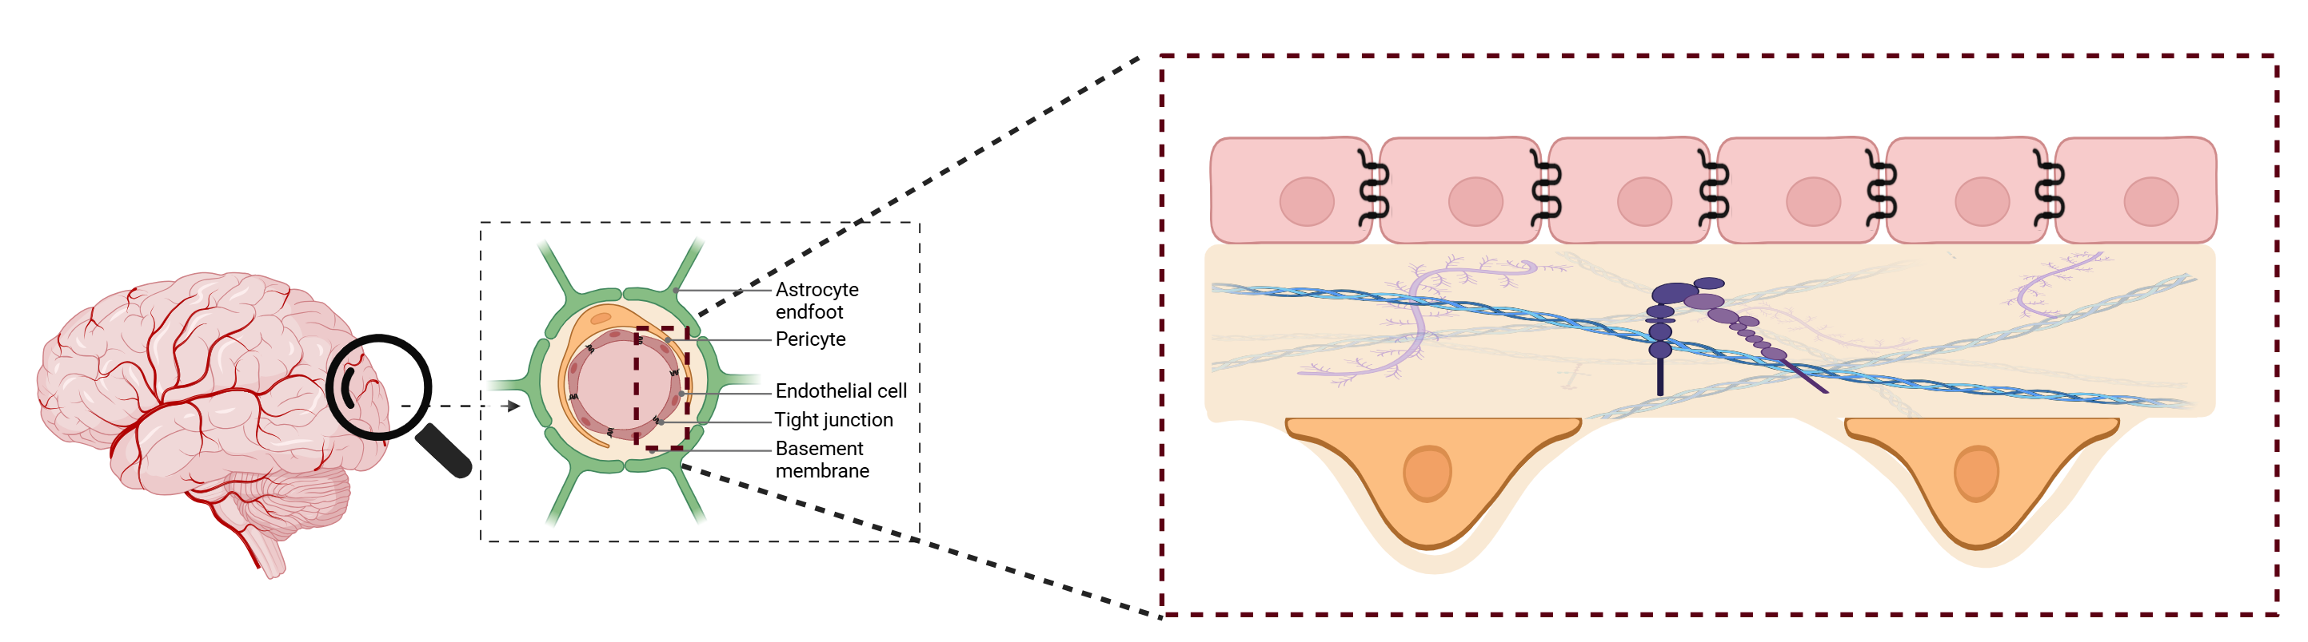
Blood-Brain Barrier (BBB)
Tight junction
Endothelial cell
BBB cross section
Basement membrane
Collagen
Laminins
Perlecans
Nidogens
Pericytes
2
Notes:
Talk about endothelial cells-tight and adherent junctions , restricted molecules movement
In the next slides we will talk about what components help in formation of basement membrane and

Slide 4
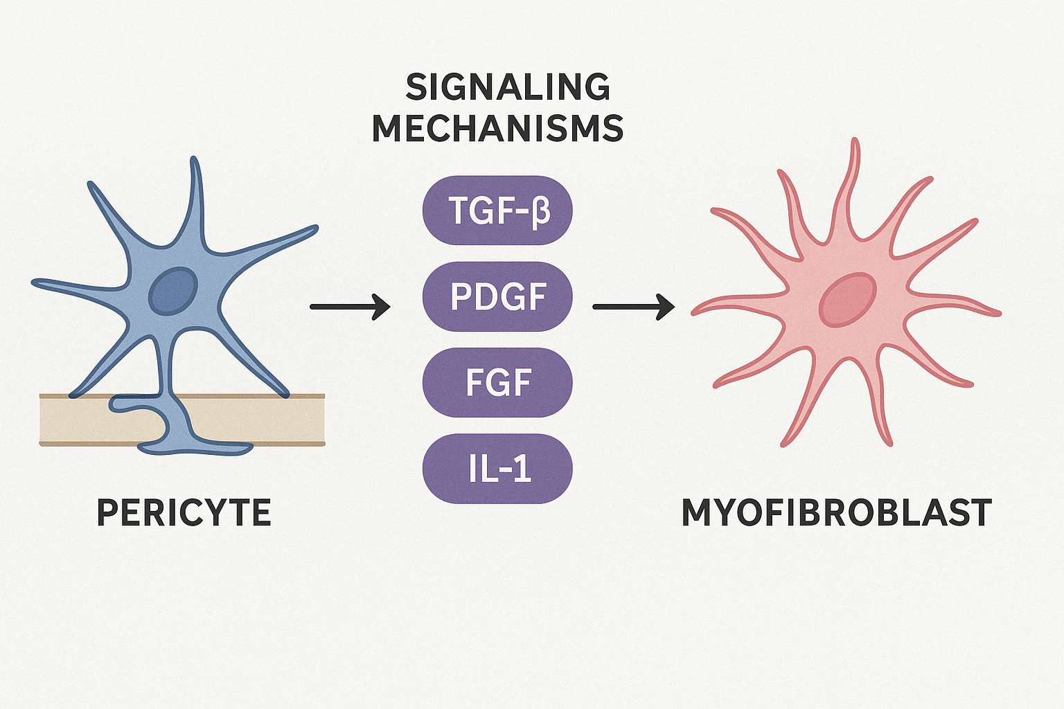
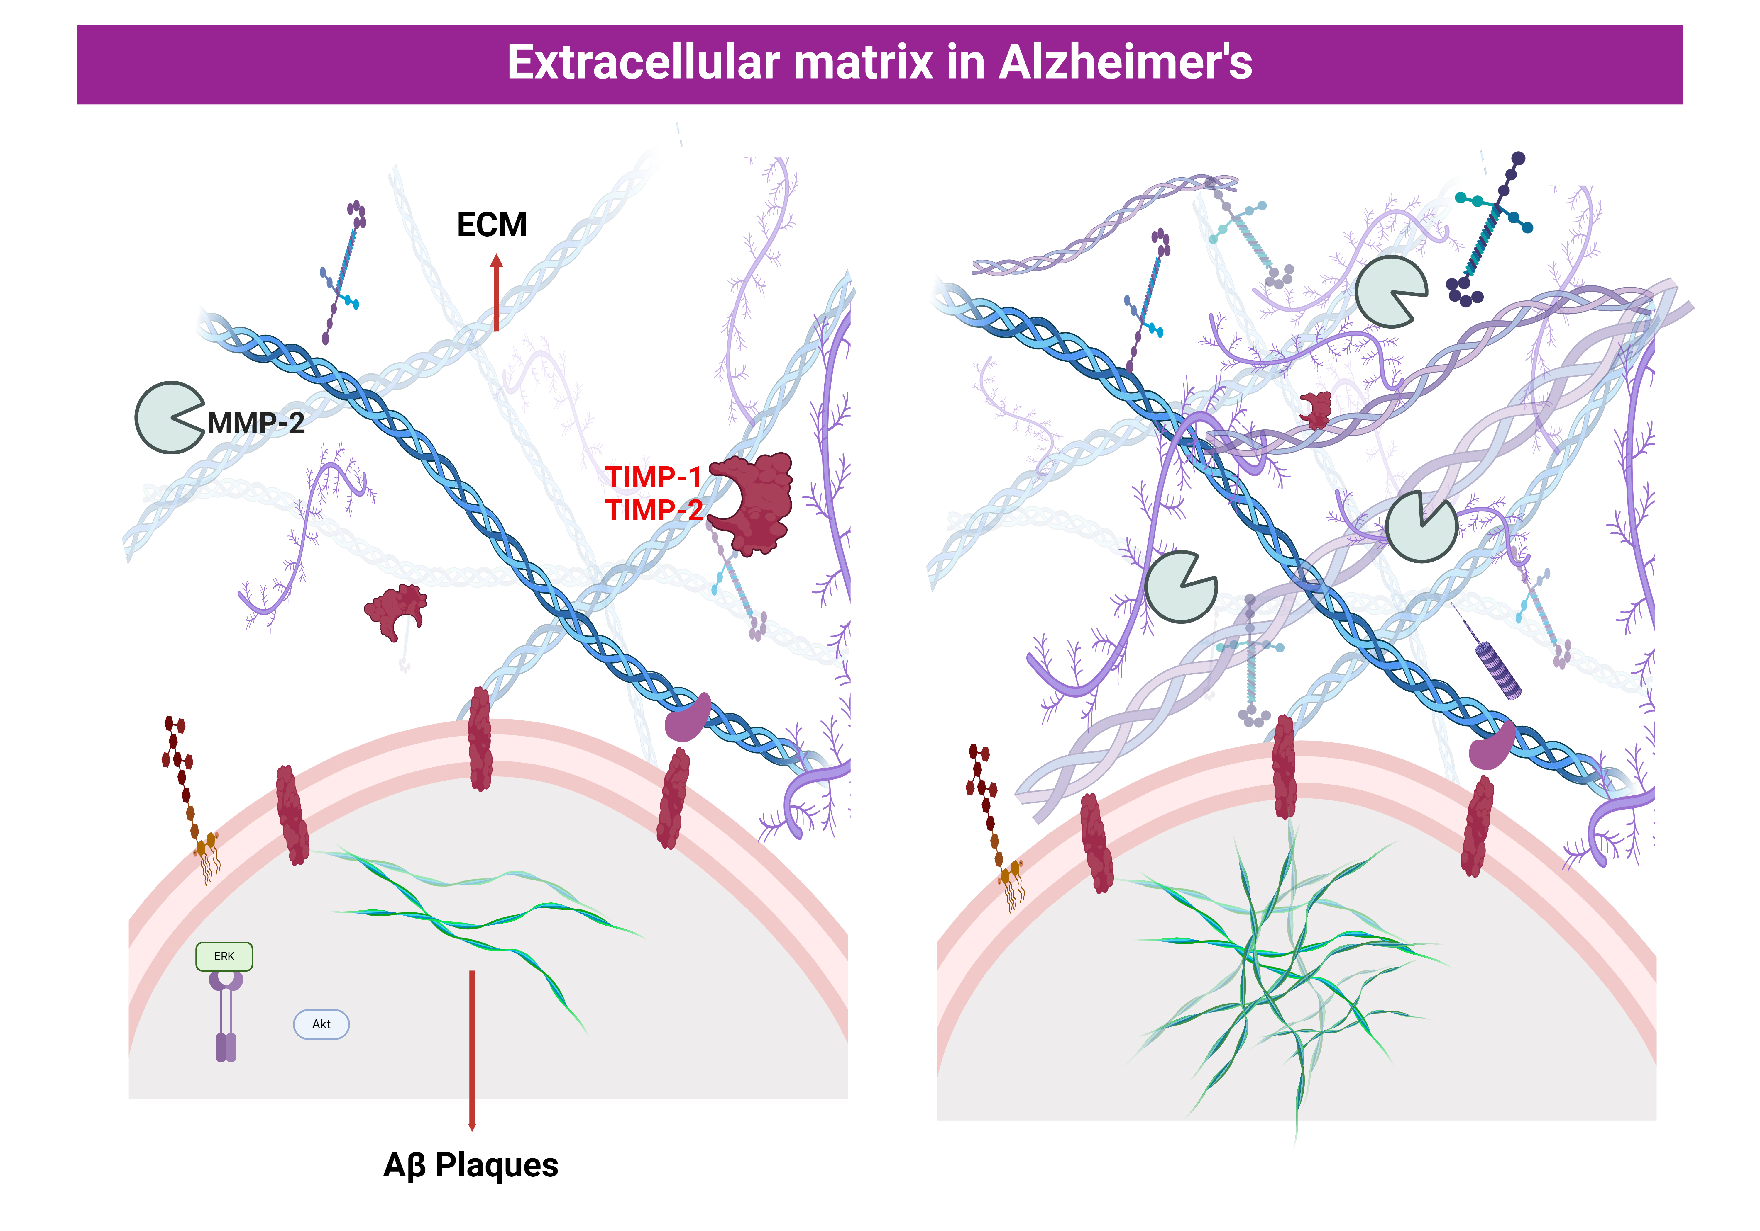
Fibrosis
Disease condition
Damage to pericytes
Addition of growth factors
Formation of myofibroblasts
Excessive production of collagen
Fibrosis
3

Slide 5
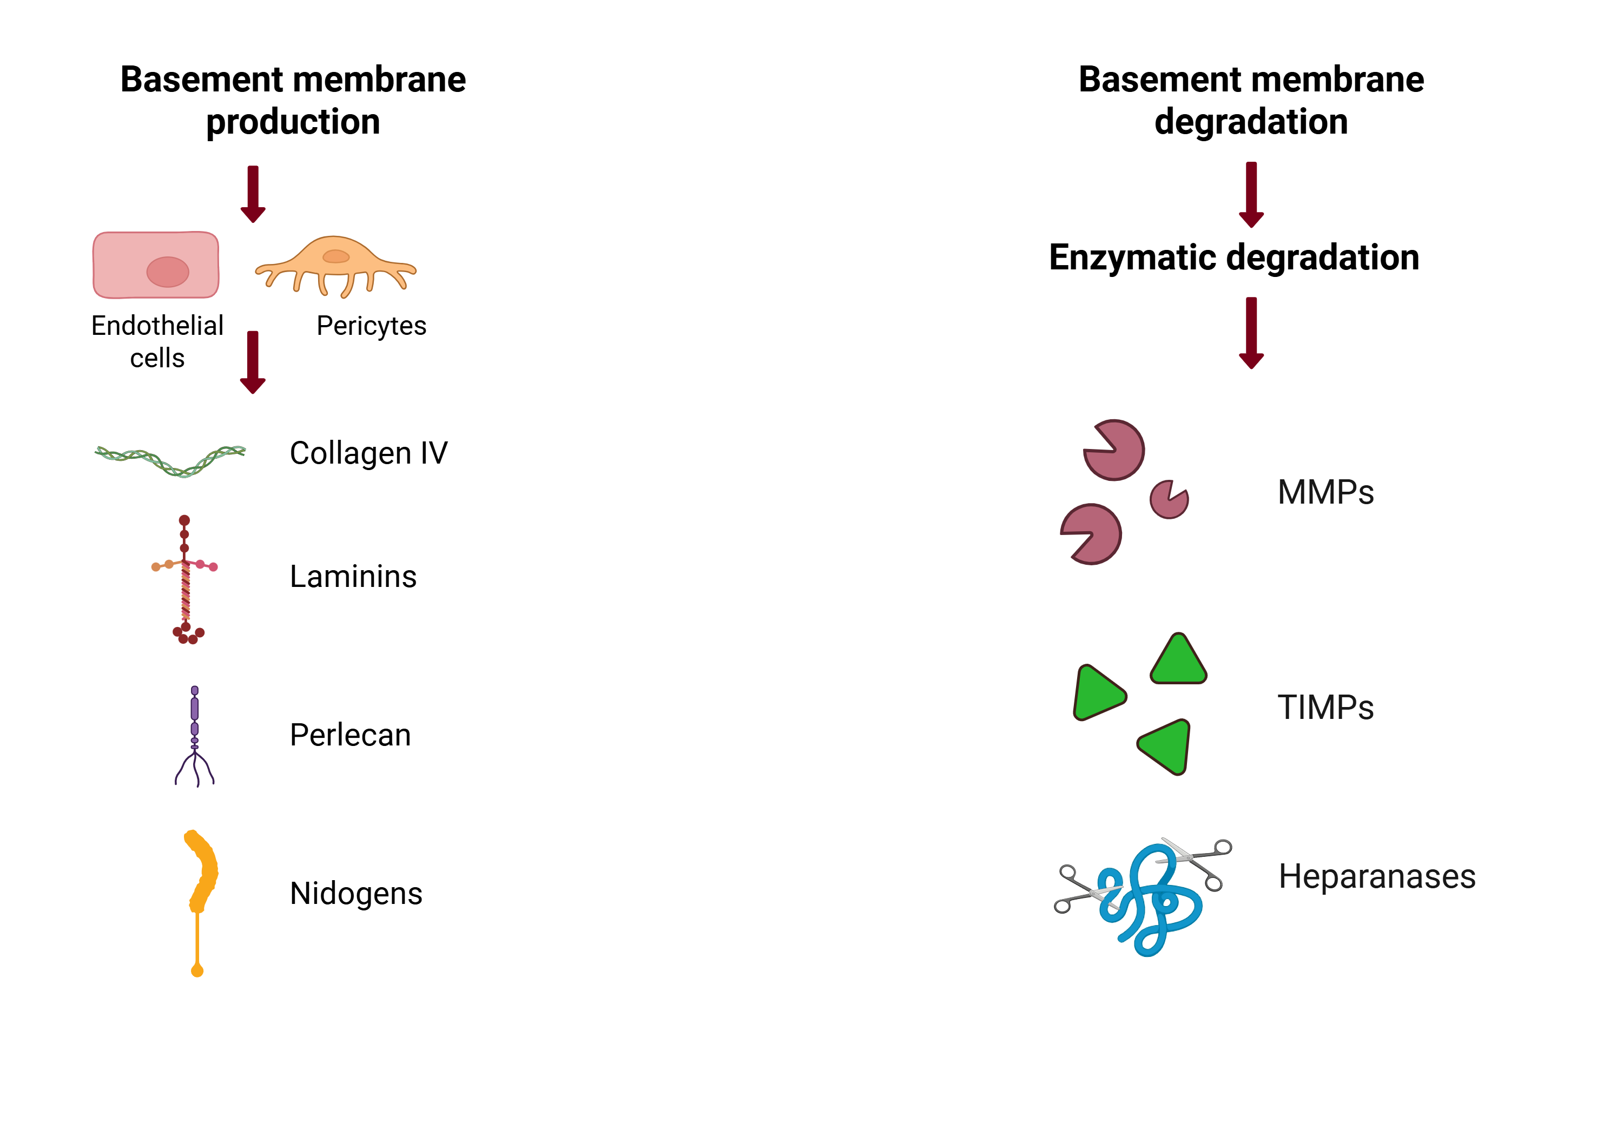
Basement membrane production and degradation
TIMP
MMP
Timp1
Timp2
MMP2
MMP9
Excessive accumulation of Collagen - Fibrosis
4

Slide 6
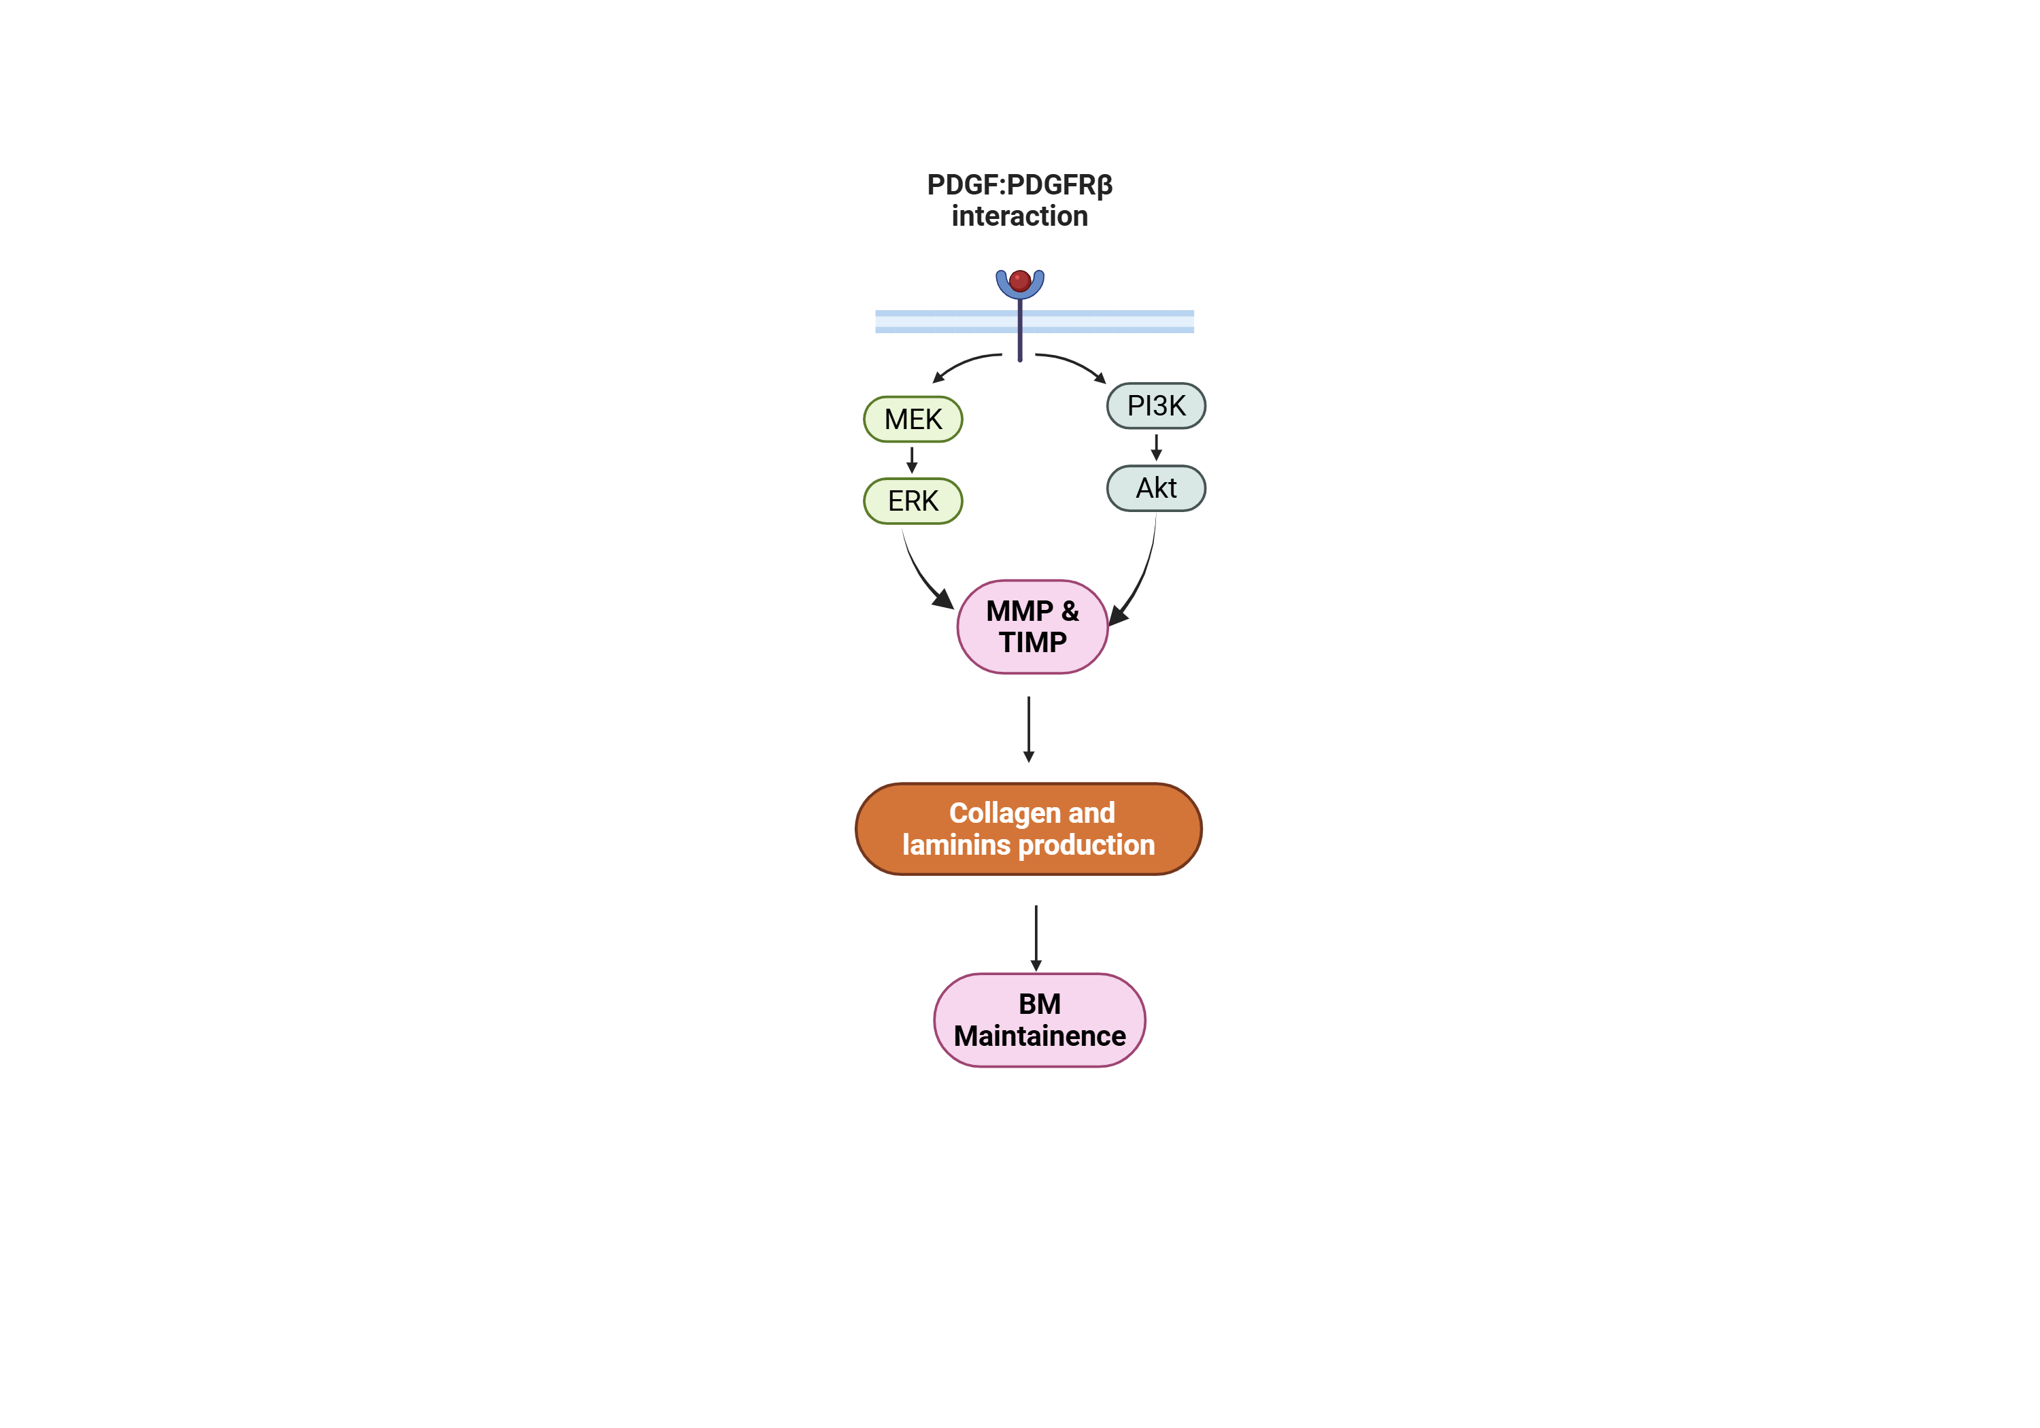
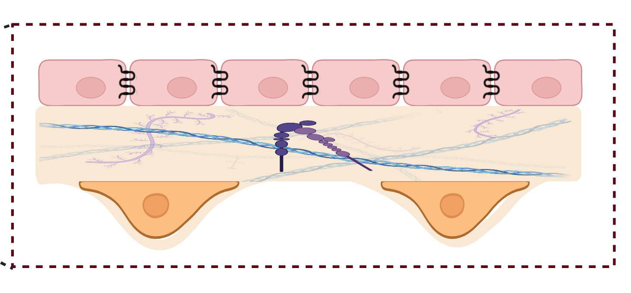
PDGF-BB: PDGFRβ signaling interactions
Endothelial cells
PDGF-BB: Platelet - derived growth factor (Dimer)
PDGFRβ
PDGF Receptor β
Pericytes
5
Notes:
To test those first we have to identify the importane interactions between pericytes and endothelial cells
One of the is pdgf etcccc

Slide 7
Summary
Amyloid beta exposure & insulin resistance
Pericyte degeneration
Disrupted PDGF-BB:PDGFRβ Interaction
Dysregulated BM components
BBB dysfunction in AD
6

Slide 8
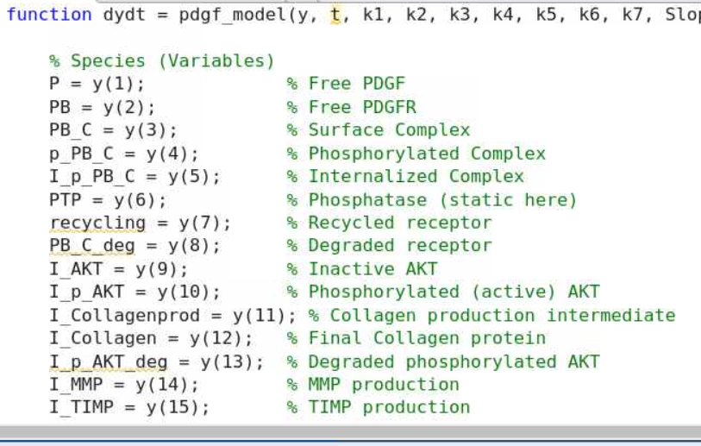
Model
Aim:
Simulate the Basement membrane in the BBB endothelium to analyze the impact of amyloid beta peptides on collagen production and degradation
Method:
MATLAB ODE45
Steps:
Write DE’s for state variables
Set parameters
Set initial conditions for Control and Amyloid treatment from literature
7

Slide 9
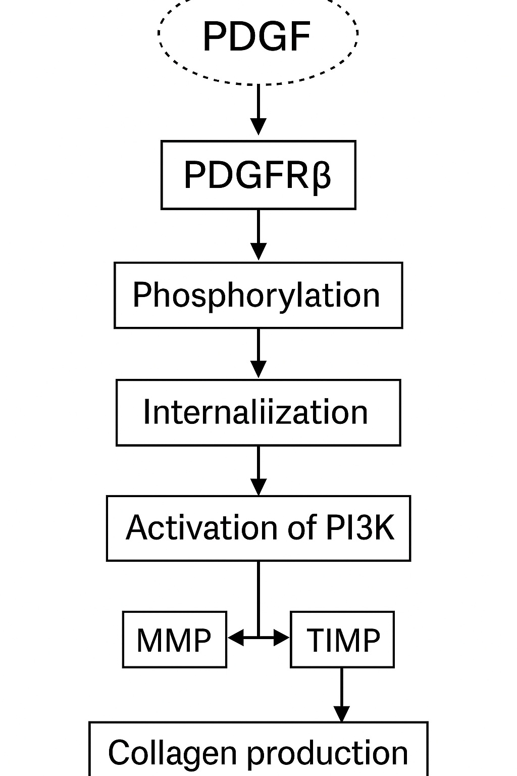
Steps in the model

Slide 10
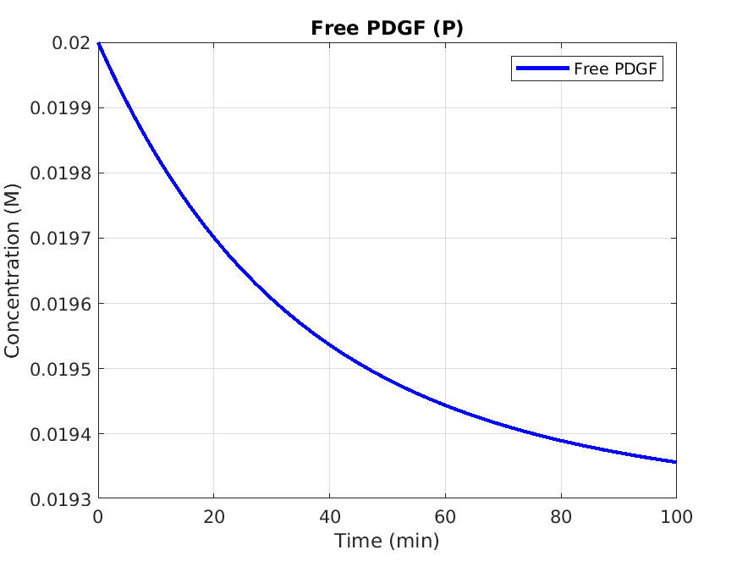
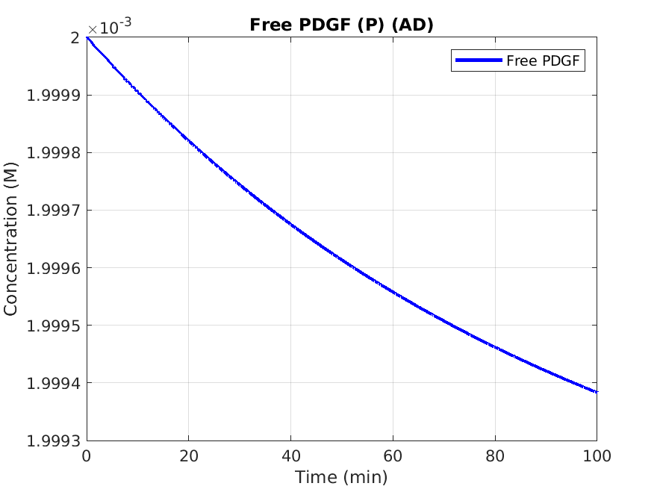
Levels of PDGF decreased in AD
8

Slide 11
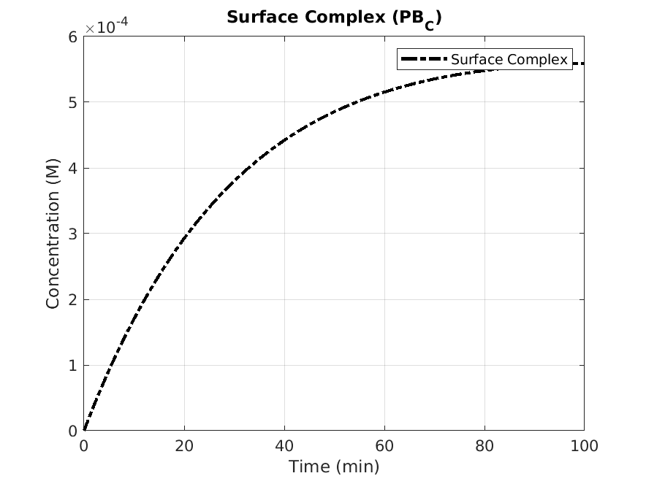
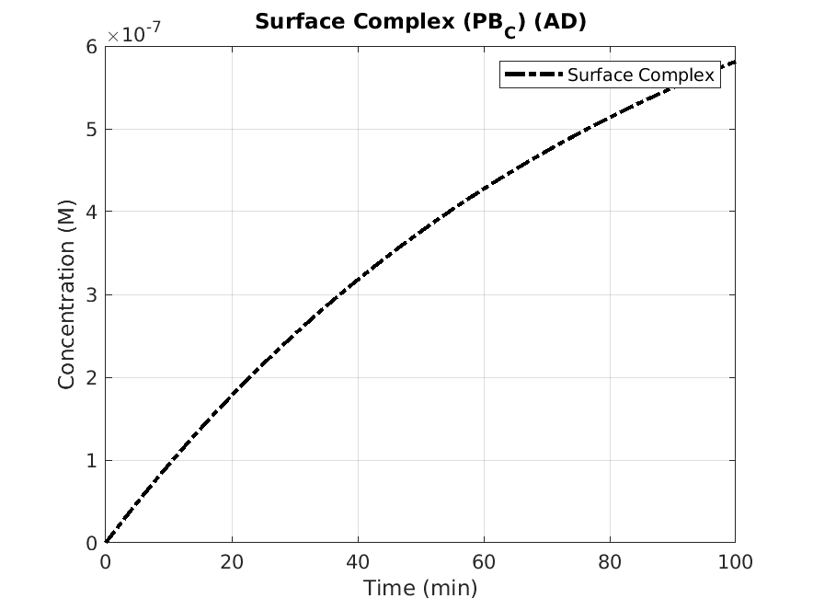
Slow formation of complex as pericyte loss observed in AD
9

Slide 12
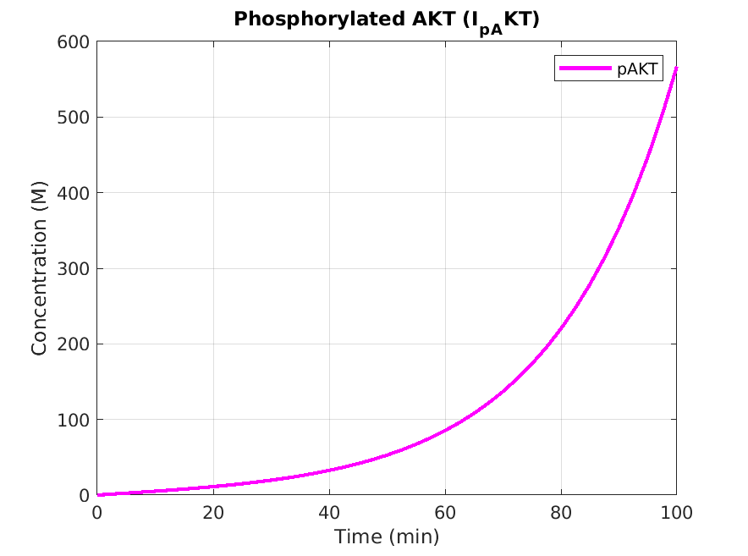
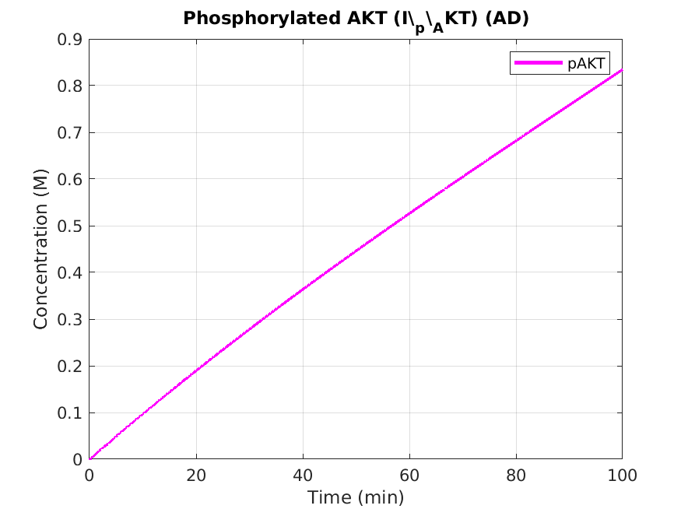
Levels of p-AKT decreased in AD
10

Slide 13
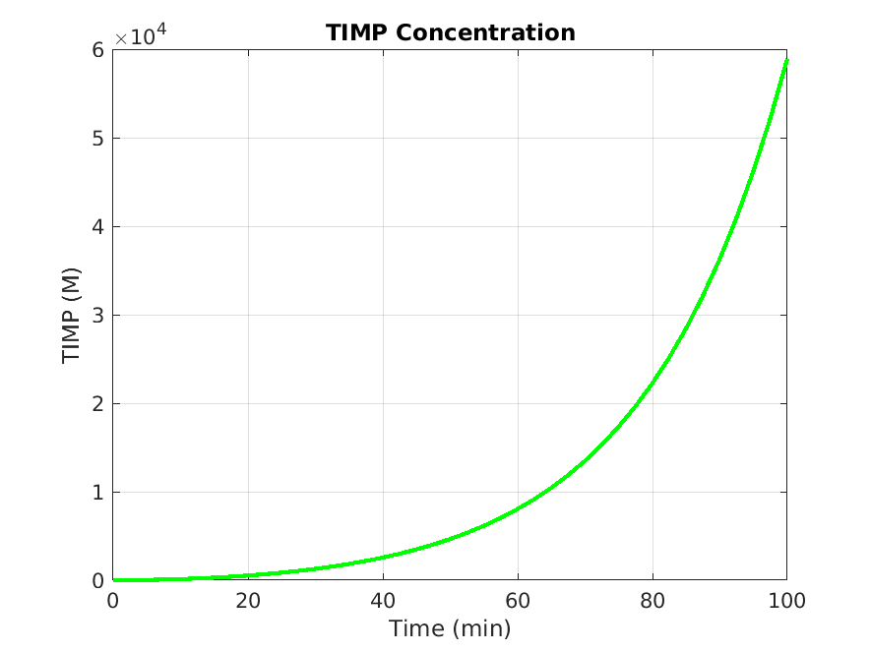
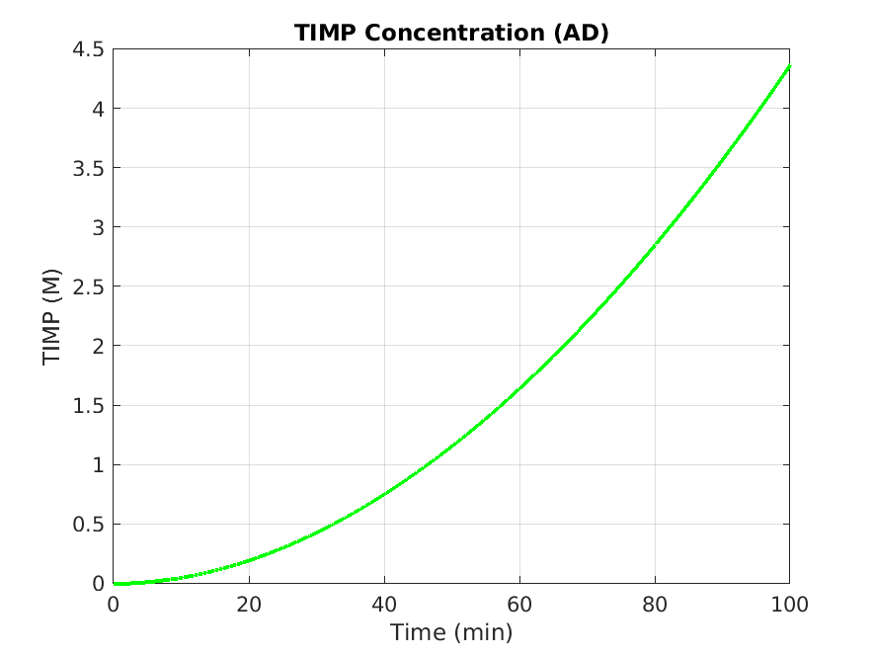
Levels of TIMP decreased in AD
11

Slide 14
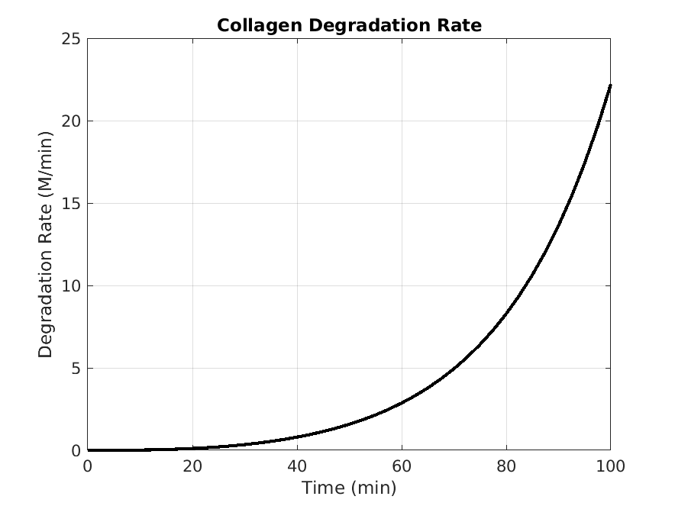
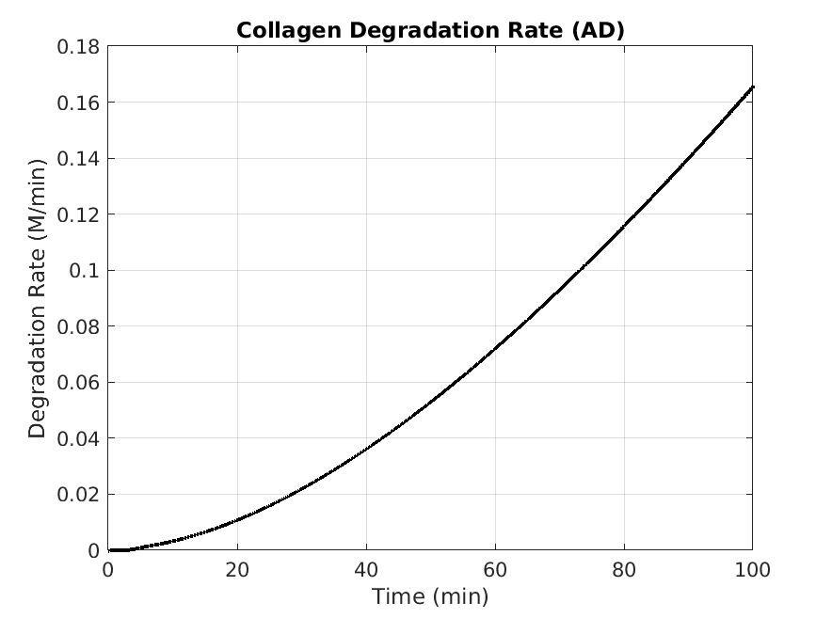
Rate of degradation of collagen decreased in AD
12

Slide 15
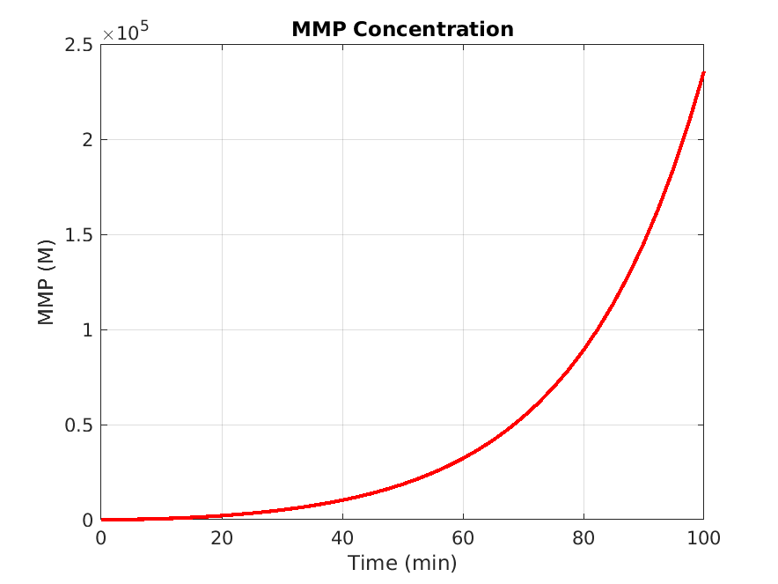
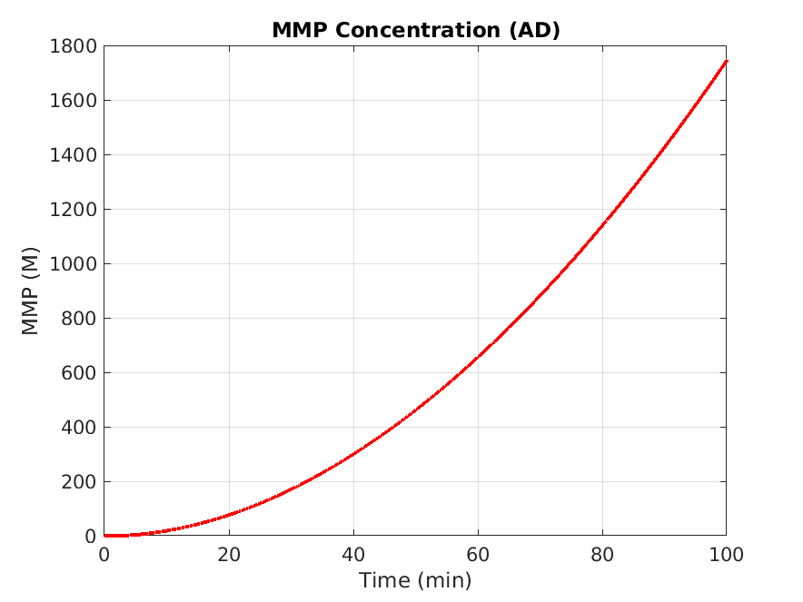
Levels of MMP decreased in AD
13

Slide 16
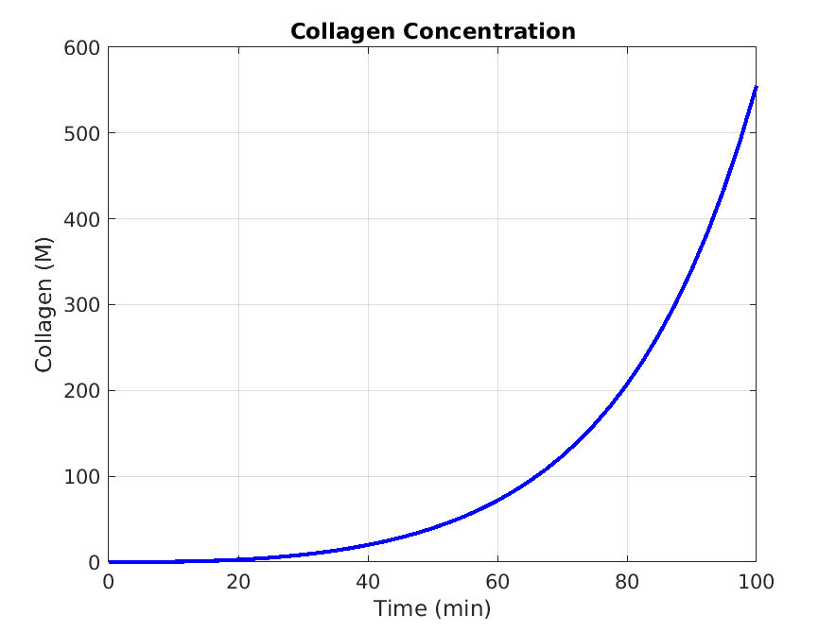
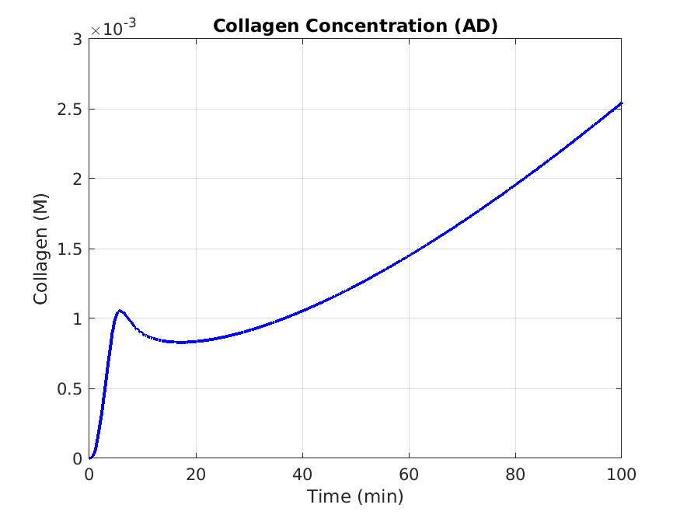
Decrease in total collagen levels in AD
14

Slide 17
Conclusion
PDGF
PDGFB-complex
p-AKT
MMP
TIMP
Collagen production
Collagen degradation
Imbalance in
MMP & TIMP
in AD
TIMP
MMP
15

Slide 18
Future directions
Optimize the simulation by working with other ODE’s to simulate the existing model better
Add ERK and TGF beta pathway to the model
Simulate the other BM proteins expression in the hyperinsulinemia conditions for both pathways
Further develop a model to incorporate patient data
16

Slide 19
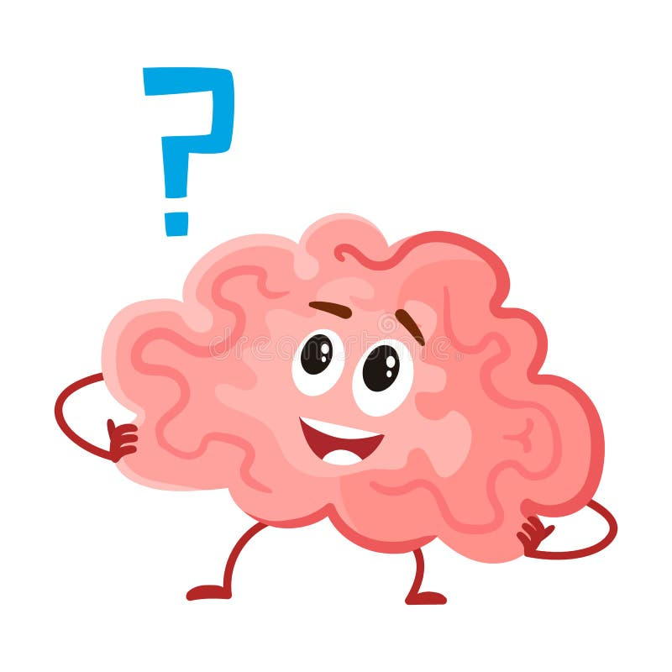
Thank you
Any Questions

Slide 20


Slide 21
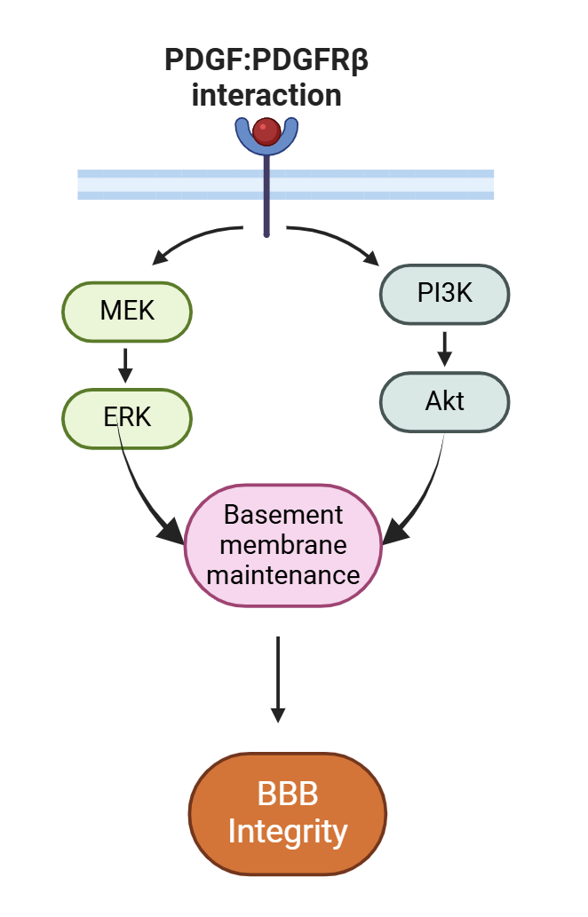
Co-culture effects on p-AKT & p-ERK
Endothelial Cells
(EC)
Pericytes (PC)
Fold change
pAKT and pERK increased in the co-cultures
PC (Co-culture)
PC (Co-culture)
PC alone
PC alone
Wang Z et al. thesis
15
Notes:
We next investigated the insulin signaling pathway because we hypothesized it was activated in the co-cultures. Specifically, here we measured the phosphorylation levels of two major insulin signaling kinase, AKT and ERK. Intriguingly, we found that ERK and AKT phosphorylation was significantly increased in the endothelial cells when co-cultured with pericytes for 7 days, but no effect was observed in the 2-day co-culture model. However, in pericytes, both 2-day and 7-day co-culture significantly increased the AKT and ERK phosphorylations, indicating activation of the insulin signaling pathway.

Slide 22
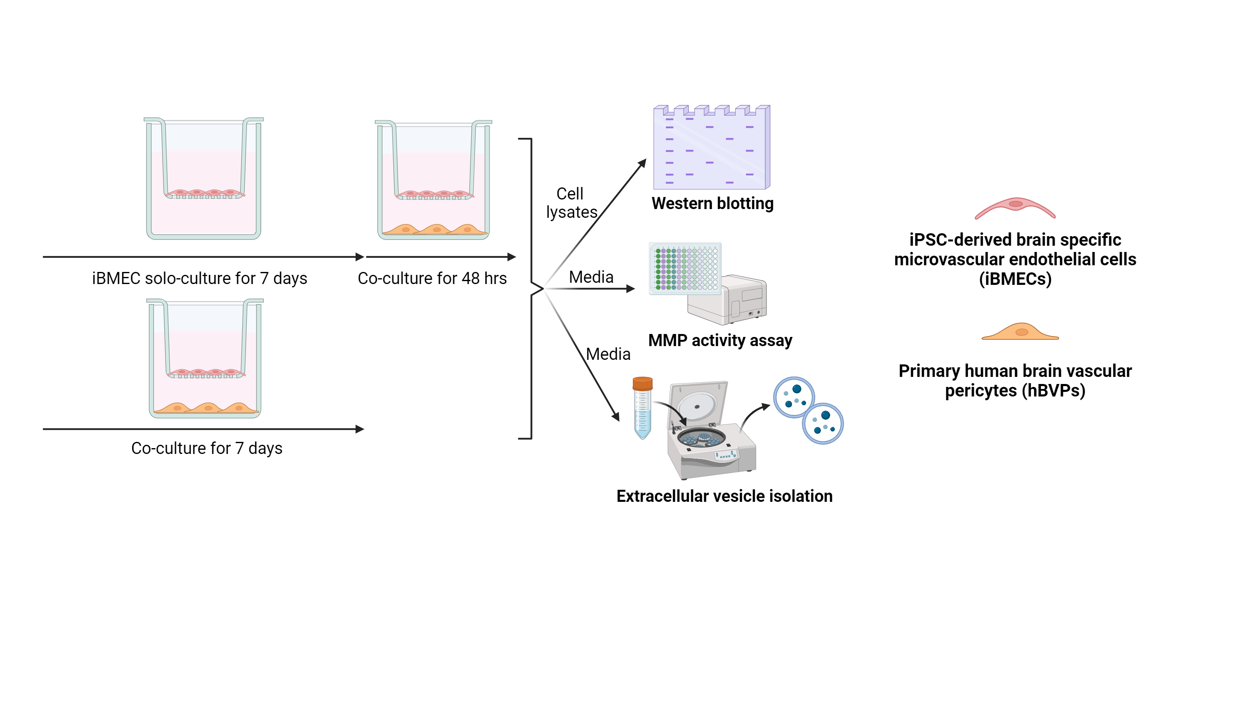
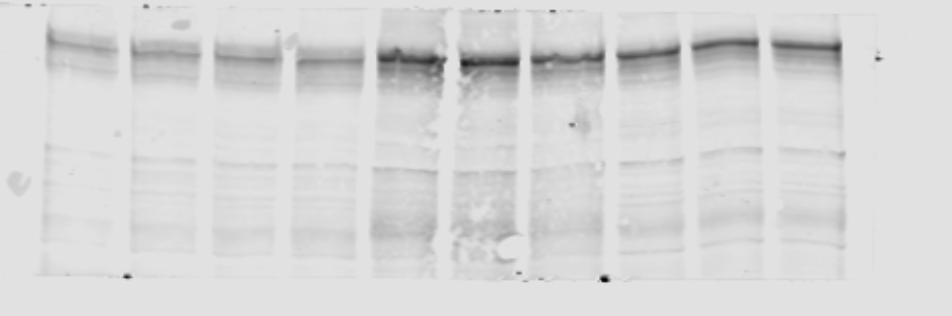
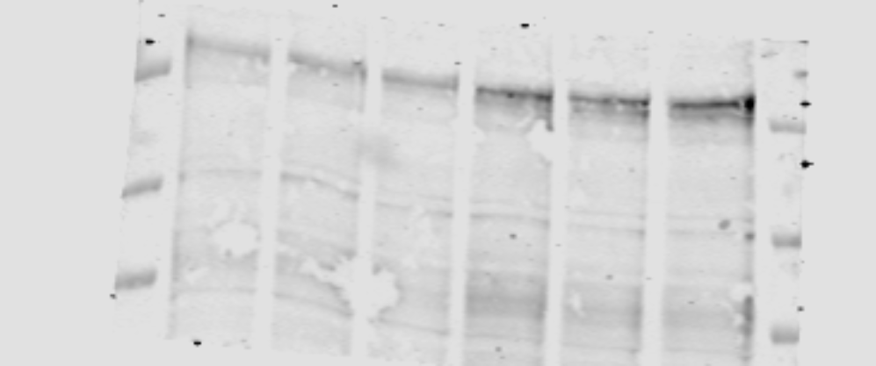
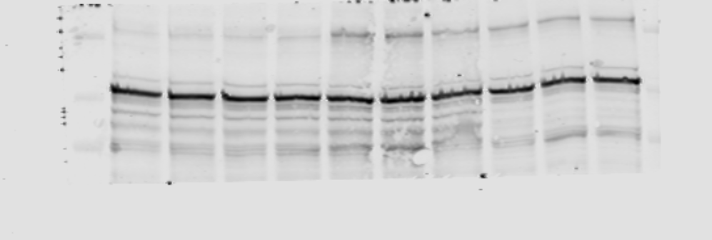
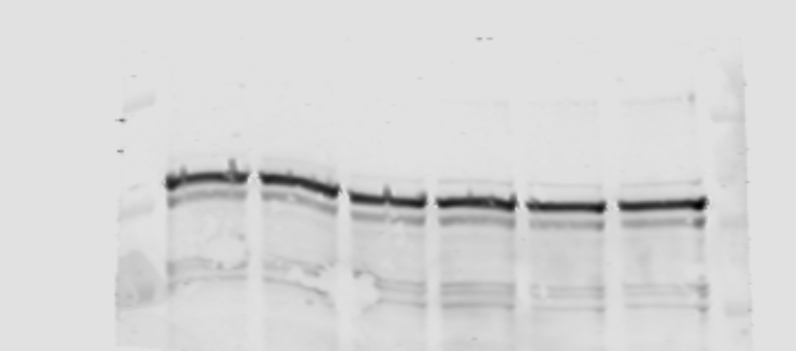
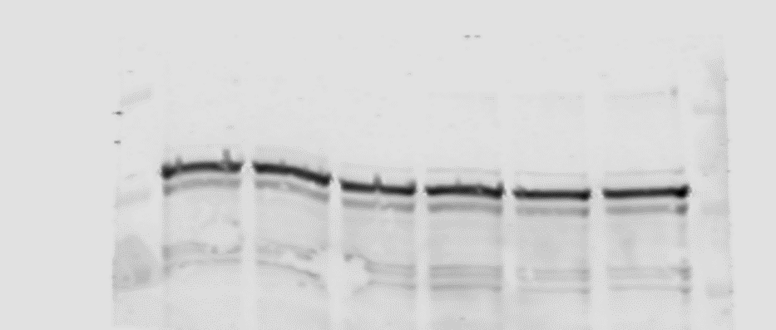
Co-culture effect on BM components
EC (Co-culture)
Endothelial cells (EC)
PC (Co-culture)
48-hr
7-day
PC alone
PC (Co-culture)
PC alone
PC (Co-culture)
Pericytes (PC)
Collagen-IV
Vinculin
Wang Z et al. thesis
14
Notes:
On this slide, we examined the protein expression of TIMP1 and collagen-IV in iBMEC and pericyte solo-culture versus co-cultures. The top western blots showed the TIMP1 expression.
For TIMP1, its expression was upregulated in endothelial cells co-culture models compared to solo-cultures, for both 2 days and 7 days. In the pericytes, TIMP1 expression also increased but only observed in the 2-day co-culture.
We also measured MMP activity and it was inhibited in the co-culture model.
Because COL4 is a substrate of MMP and a major component of the basal lamina of BBB. Its expression increased in both cell types, and in both co-culture durations.
These results suggested that the interaction between endothelial cells and pericytes can increase the TIMP1 expression, inhibit the MMP activity and protect collagen from degradation, thereby improve the BBB integrity.

Slide 23
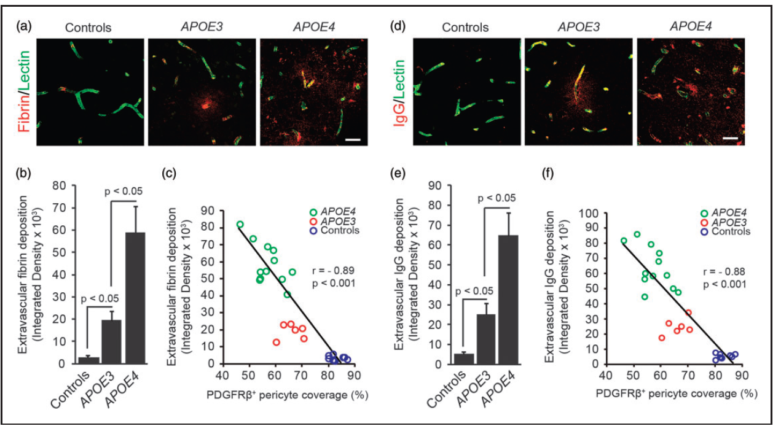
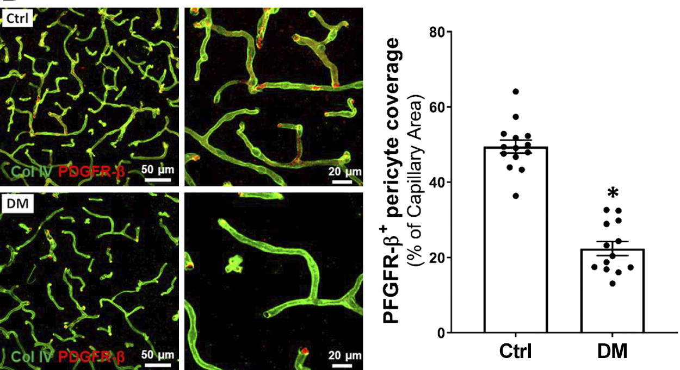
Pericyte loss in AD and T2DM brain vasculature
Diabetes Miletus – Mice brain
AD patient brain
Key takeaways: In AD and T2DM - loss of pericytes & BBB integrity
Molecular mechanisms?
Liu Y, et al. Am J Physiol Heart Circ Physiol. 2021; Halliday MR, et al. J Cereb Blood Flow Metab. 2016
5
Notes:
We saw what happens to vesells when pericyes degenerate in broader perspective
Now lets dive into molecular level and understand the changes

Slide 24
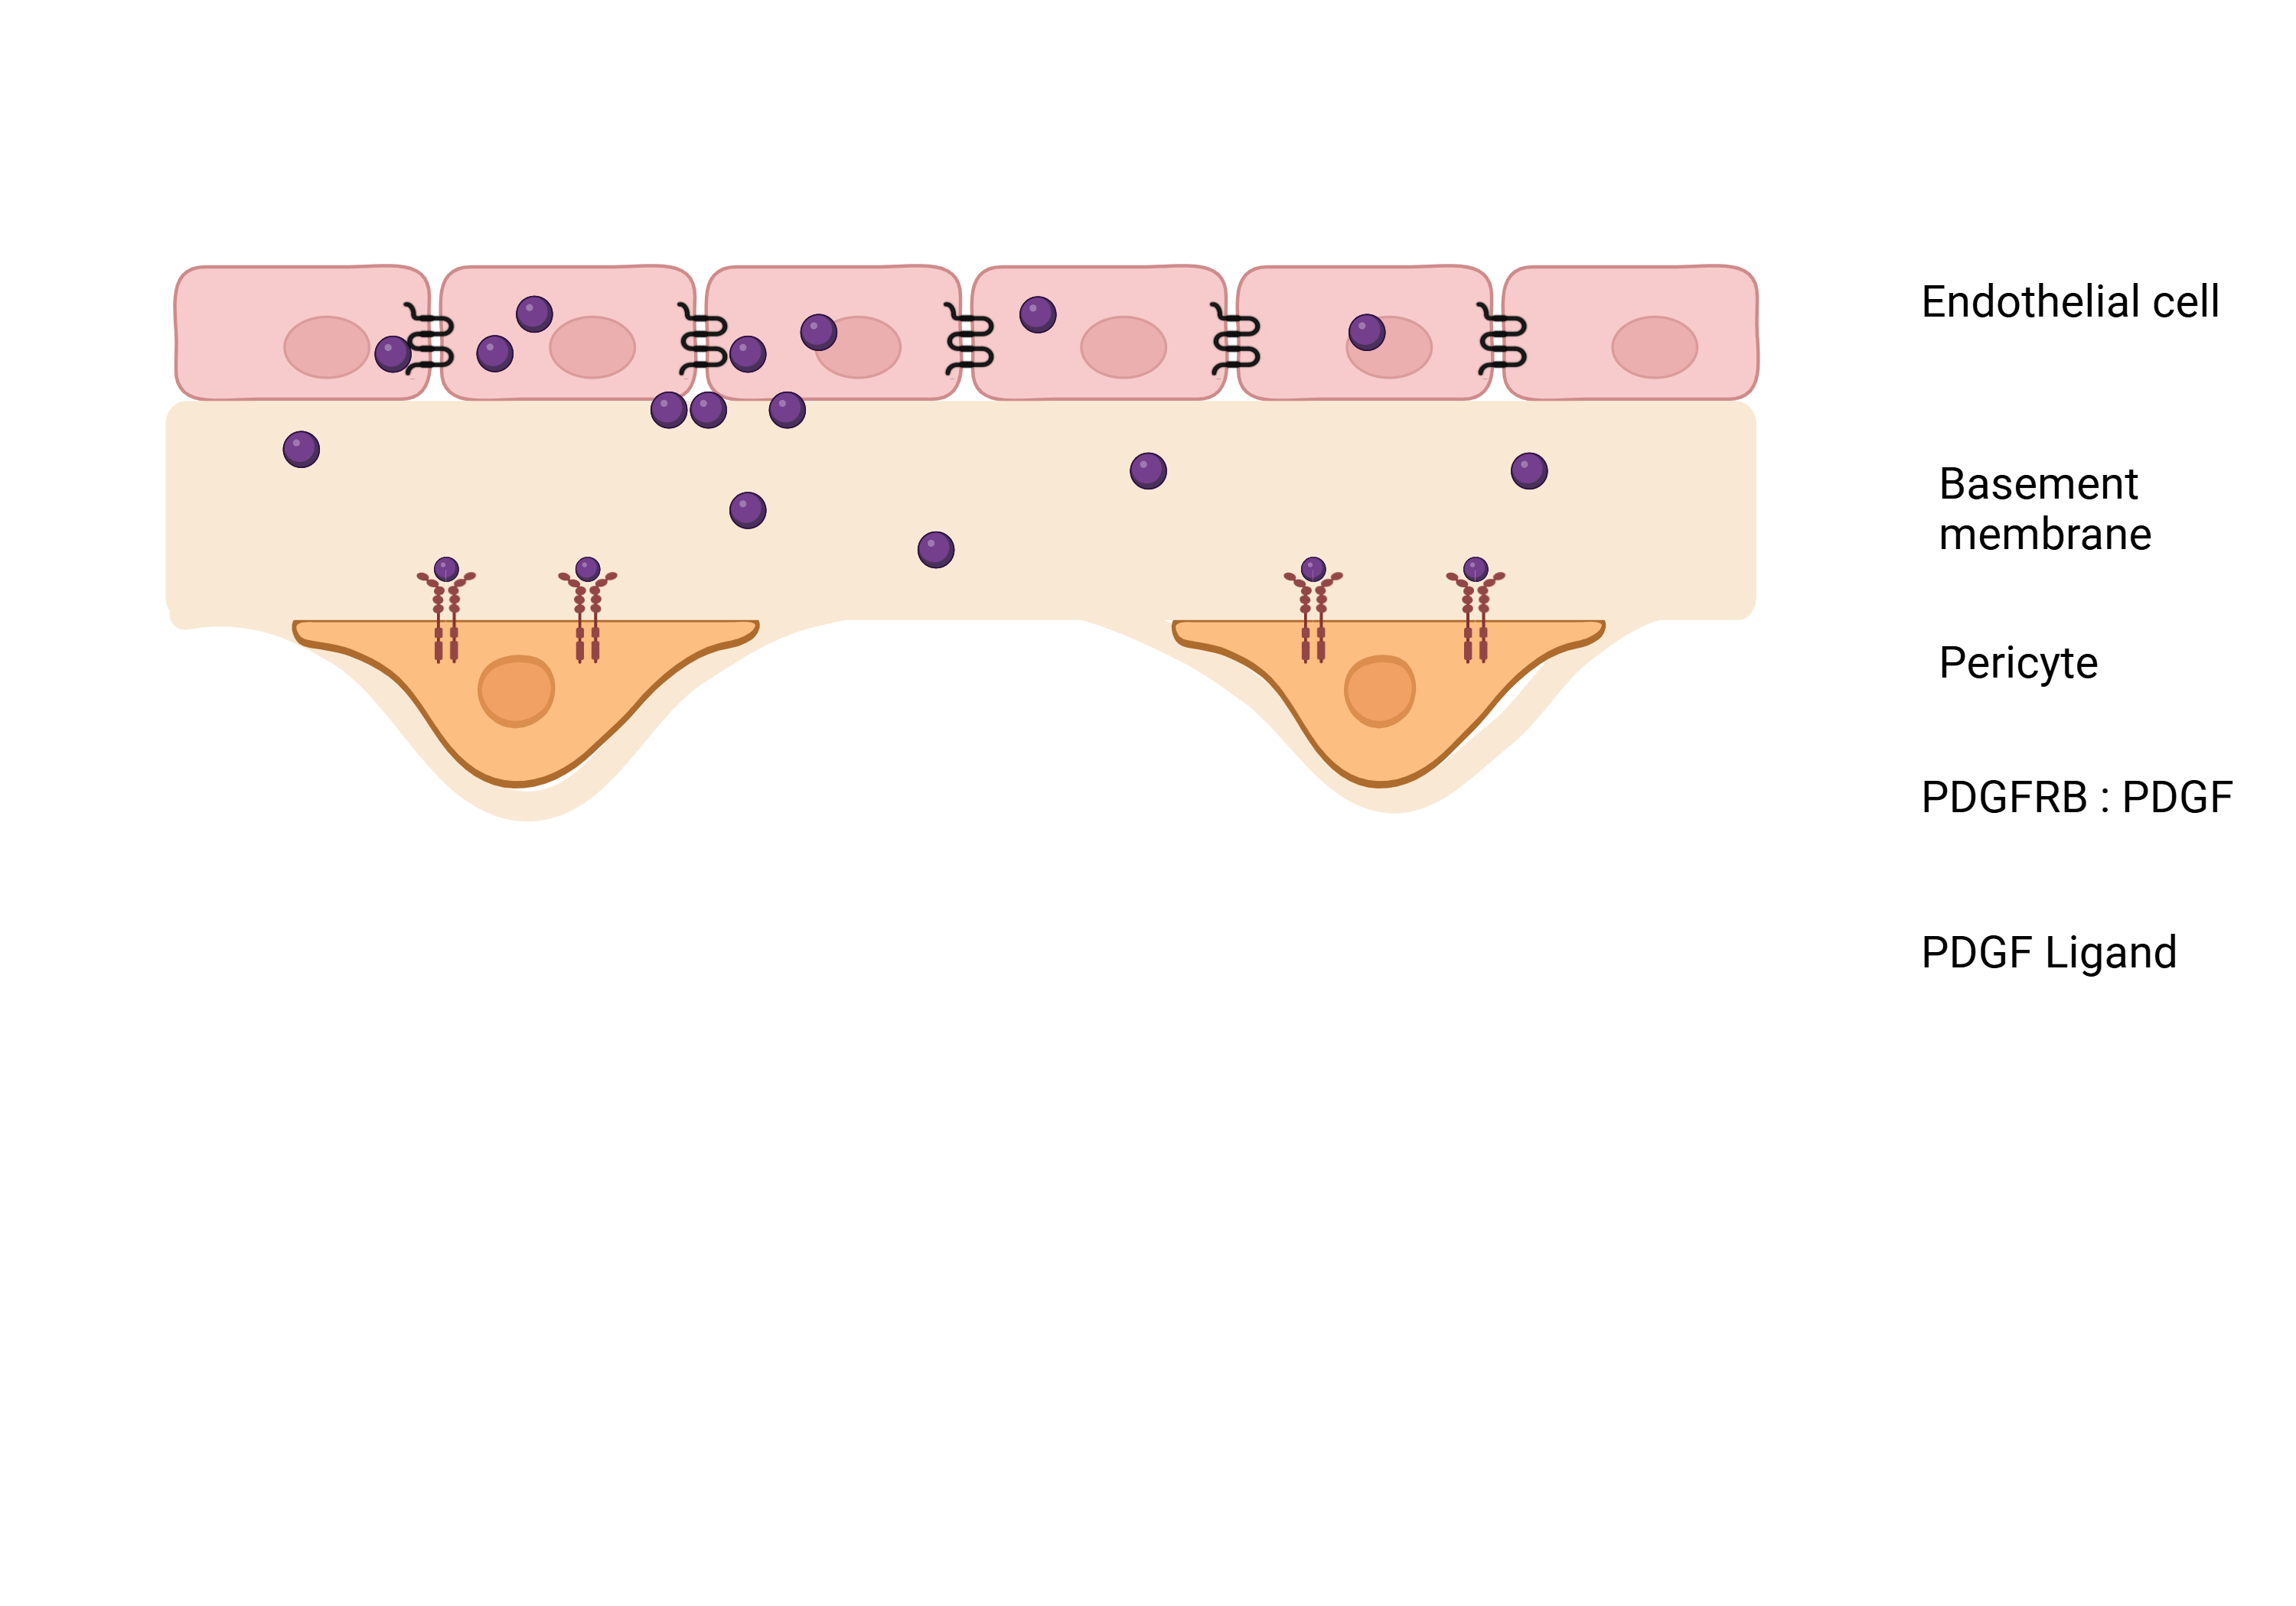
PDGF-BB:PDGFRβ Interaction
PDGF-BB is released by endothelial cells
Sequestered in the basement membrane and interacts with the BM protein perlecan
Forms a concentration gradient in BM
Diffused PDGF-BB identified by PDGFRβ
PDGF-BB :PDGFRβ interaction
Activation of MAPK, AKT, and STAT pathways
PDGF-BB
PDGFRβ
Smyth Commun Biol 5, 235 (2022). Göhring et. Al., European journal of biochemistry
9

